Slide 1
Titiksha Ghosh Zhong Chen Xuejia Li Lystra Injamuri Naveen
PJM 5900 – Foundations of Project Management
Prof. Cheryl Gross
Quantum Bank
Status Report

Slide 2
A brief description of the project
The Quantum bank launched a mobile banking application in 2016.
The primary goal of the project is to improve the services in the existing application and expand the reputation in the new geographical areas.
This project is about upgrading existing banking application with new features like Bill Payment, Loans, New Account Opening, Managing Investment Profiles etc.
The project outcomes: 1. Increase in revenue for our bank 2. Increase contracted business partners 3. Increase in user number and transactions. 4. Expand awareness/reputation of our brand
Notes:
I have some exciting news to share from The Quantum bank. In 2016, we launched our mobile banking application, and today, we are embarking on a project to take it even further.
Our primary goal is to enhance the existing application and expand our reputation into new geographical areas. We aim to provide an improved banking experience by upgrading the app with new features such as Bill Payment, Loans, New Account Opening, and Managing Investment Profiles.
The outcomes we anticipate are promising: an increase in revenue, more contracted business partners, a rise in user numbers and transactions, and an expanded awareness of our brand. This project is an opportunity for us to grow, innovate, and establish ourselves as leaders in the mobile banking industry.

Slide 3
Expected benefits
Enhanced security: Quantum computing can provide improved security capabilities for banking systems. Quantum-resistant cryptographic algorithms can be employed to protect sensitive financial data and transactions, ensuring robust security even against attacks from quantum computers.
Faster data processing and analysis: Quantum computers have the potential to solve certain complex computational problems much faster than classical computers.
Optimization of financial operations: Quantum algorithms and optimization techniques can assist banks in solving complex optimization problems. For example, quantum computing can be applied to improve asset-liability management, portfolio optimization, and transaction settlement processes.
Advanced data analytics: Quantum computers have the potential to analyze large datasets and extract meaningful insights efficiently. Banks can utilize quantum algorithms and machine learning techniques to gain deeper insights into customer behavior, identify patterns, and develop more personalized financial products and services.
Innovations in financial modeling: Quantum computing can enable more sophisticated financial modeling and simulation capabilities. Complex financial models, such as Monte Carlo simulations for pricing derivatives or optimizing investment strategies, can be executed more accurately and efficiently with quantum algorithms.

Slide 4
Reporting Period
Start time: 4/10/2023
Report meeting 1: 5/3/2023
Report meeting3: 7/3/2023
End time: 7/25/2023
Report meeting2: 6/5/2023

Slide 5
Project Summary
secure
innovative
Customer experience+business+financial market
Efficient
Notes:
Summary: The Quantum Bank App enhance aims to provide more efficient, secure and innovative banking services. By introducing advanced technology and functionality, the project will improve customer experience, enhance business process efficiency, and meet the requirements of the changing financial market

Slide 6
Schedule Summary
Project initiation and planning phase
20 Days
Project Development
20 Days
Project Testing
7 Days
After sale service

Slide 7

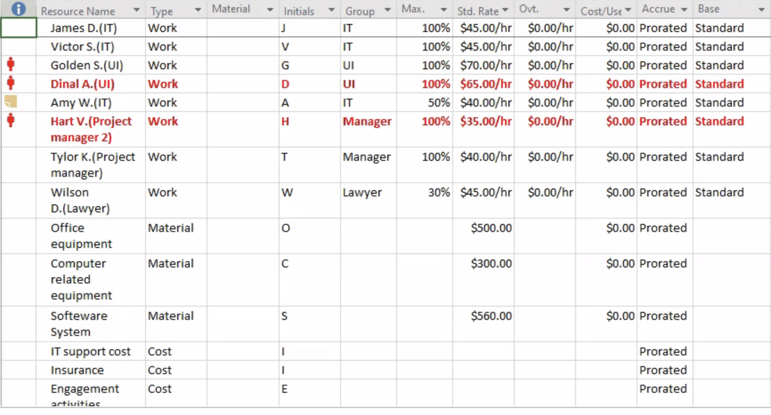
Budget
Notes:
Human Resource Costs
Includes salaries and benefits for project managers, developers, testers, trainers, etc.
Hardware and software purchase costs
Includes the cost of purchasing hardware and software such as new servers, network equipment, storage devices, and licenses.
Cost of external services
Includes outsourcing costs for system design and development, as well as external expenses such as testing, training and consulting services.
Internal support costs
Includes training, travel and other project support costs for internal teams.
Set-aside and Risk Management
Set-aside funds to address potential change requirements, risk response, and project risks.

Slide 8



Significant Accomplishments
Successful implementation of computing technology within the bank's operations. This achievement would involve:
Integrating systems
Improved security measures
Optimized banking process
Enhanced risk assessment

Slide 9
Issues & Resolutions
Technical complexity
Security and privacy concerns
Talent and skill gap
Scalability and integration

Slide 10
Anticipated Risks
Security vulnerabilities
Operational challenges
Cost and scalability
Talent and expertise
Regulatory and legal considerations
Ethical implications

Slide 11
Lesson Learned
Project plan will not always meet the reality (Risks)
Budget and timeframes are dependent on the efficiency of whole team
Project manager requires to monitor activities one by one to keep everything on track and within budget.
WBS is crucial for every project planning
Budget are hard to forecast since it related to outside resource of company. (suppliers and contractors)
Communication is important between teammates; crews and manager; stakeholders and manager; public (media) and company.
Difficult for manager to measure the ultimate outcome. For instance, 30% increase in total use of application and 48% of increase in transaction of new user.
Notes:
I would like to highlight an important aspect of project management: the realization that project plans may not always align with reality. There are inherent risks involved that we must consider.
The success of a project, particularly in terms of budget and timeframes, heavily relies on the efficiency and collaboration of the entire team. It is the project manager's responsibility to closely monitor activities, ensuring that everything stays on track and within the allocated budget.
A well-defined Work Breakdown Structure (WBS) is crucial for effective project planning. Breaking down tasks into manageable components facilitates resource allocation, task dependencies, and progress tracking.
Forecasting budgets can be challenging as they are often linked to external resources, such as suppliers and contractors. Factors beyond our control can impact budgetary projections.
Communication plays a vital role throughout the project, involving effective coordination among team members, crews, stakeholders, and the public or media. Open channels of communication are key to success.
Measuring the ultimate outcome can be difficult for a manager. For instance, determining a specific increase, like a 30% rise in total application usage or a 48% boost in transactions by new users, requires careful analysis and consideration of multiple factors.
By acknowledging these risks and implementing proactive measures, we can navigate challenges, adapt to changing circumstances, and increase our chances of project success. Thank you for your attention.

Slide 12
References
Meredith, J. R., & Shafer, S. M. (2021). Chapter 2 - Case Study: The Quantum Bank. In Project Management in Practice. essay, Wiley.

